Slide 1
Discovering a Relationship between Company Stock Prices and their Internet Presence
Project authors: Anna Burlyaeva, Gaurav Maheshwari

Slide 2

Motivation
Predicting how the stock market will perform is one of the most difficult things to do. There are so many factors involved in the prediction – physical and psychologistic, rational and irrational behavior, etc. All these aspects combine to make share prices volatile and very difficult to predict with a high degree of accuracy
Can we use various analytics techniques as a tool in this domain? Using features like the latest announcements about an organization, their stock prices statistics, etc., statistical analysis techniques have the potential to unearth patterns and insights we didn’t see before, and these can be used to describe the stock market behavior accurately

Slide 3

Motivation
Our project’s aim is to figure out is there a relationship between Company Stock Prices and their Internet Presence and to describe this relationship, if it is

Slide 4


Questions
What are the indicators of the company’s internet presence?
What data sources can we use to collect the necessary data?
What kind of relationships can be among the collected data?
What statistical model can we build to describe these relationships?
What are the characteristics of our model?

Slide 5



Internet Presence Indicators
Search Queries Statistics
Twitter Posts Statistics
Online News Statistics

Slide 6

Tools and Data Sources
Tools
pandas, numpy, json, scipy, vaderSentiment, matplotlib, sklearn and various APIs libraries
Jupyter Notebook
Data sources
Stock Data Statistics: IEX Cloud and IEX API 1.0 (https://pypi.org/project/iexfinance/)
Search Queries Statistics: Pseudo API for Google Trends (https://pypi.org/project/pytrends/)
Twitter Posts Statistics: Twitter API (https://tweepy.readthedocs.io/en/v3.5.0/)
Online News Statistics: API for searching for articles from over 30,000 news sources and blogs (https://newsapi.org/docs)

Slide 7

Data Retrieving

Slide 8

Data Cleaning Process

Slide 9
Data for Analysis
Final DataFrame includes:
Company Name
Open Stock Price
Date (1-month range from today to the past)
Google Search Popularity Rates
Twitter Sentiments (Positive Score, Negative Score, Neutral Score)
Online News Sentiments (Positive Score, Negative Score, Neutral Score)

Slide 10
Visualization

Slide 11
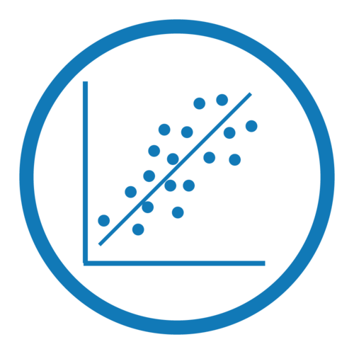
Data for Statistical Model
Dependent variable:
Open Stock Price
Independent variables:
Google Search Popularity Rate
Twitter Sentiments (Positive Score, Negative Score, Neutral Score)
Online News Sentiments (Positive Score, Negative Score, Neutral Score)

Slide 12
Model

Slide 13
Conclusion

Slide 14

Q&A
Thank you for your attention!
We are ready to answer your questions

